Slide 1
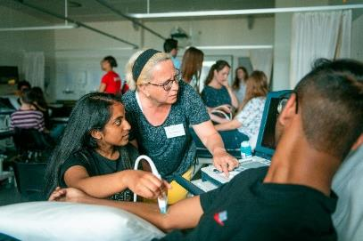
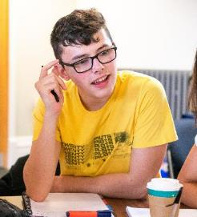
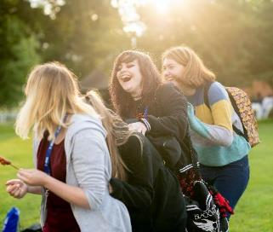
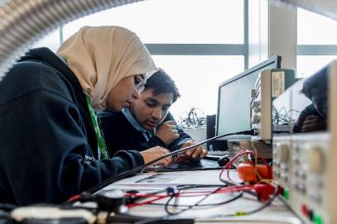
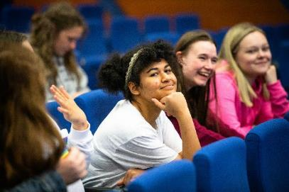

Slide 2
Who are the Sutton Trust?
The Sutton Trust champions Social Mobility from birth to the workplace through programmes, research and policy influence
Early Years
Schools
Apprenticeships
Universities
Workplaces
Notes:
Who are the Sutton Trust?
Sutton Trust champions social mobility from birth to the workplace through programmes research and policy influence.
We do this by focussing on access and quality in five key areas:
Early Years
Schools
Apprenticeships
Universities
Workplaces
Since being founded in 1997, the Sutton Trust have worked with over 40,000 students on programmes, released agenda setting research and influenced a number of policies at the local and national level to aid social mobility so that someone’s background doesn’t determine what they should achieve in life.

Slide 3
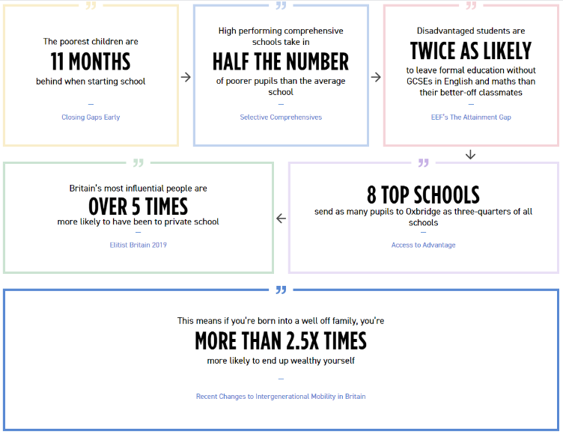
Why does the Sutton Trust exist?
Notes:
Why do the Sutton Trust exist?

Slide 4
Why do we need programmes like Sutton Trust Summer Schools?
18.6%
8
5x
14%
Gap in progression rates to HE between students on FSM and those who aren’t ¹
Independent schools send as many students to Oxbridge as ¾ of all UK Schools ²
The most advantaged applicants are five times as likely to gain a place at a top university than the least advantaged ³
The gap in acceptance rates at top universities between students at comprehensive and independent schools even when attainment is controlled for ⁴
1. Widening participation in higher education, England, 2017/18 age cohort, DfE, 2019
2. Access to advantage, Sutton Trust, 2018
3. End of cycle report 2019, UCAS, 2019
4. Access to advantage, Sutton Trust, 2018
Notes:
Why do we need programmes like Sutton Trust Summer Schools?
There is a clear and persistent access gap to HE institutions in the UK not only between the state and private sector but also between the most and least advantaged students. This is particularly pronounced for leading universities in the UK. Whilst some progress has been made in the last few years, the access gap for students in receipt of FSM and those not is the widest it has been since 2006.
Sutton Trust Summer Schools have run since 1997 to combat this. Starting with 60 students at Oxford in 1997 we are now working with 2500 students and 13 leading universities each year. Our Summer Schools help young people make informed choices about their next steps, give them the skills needed to navigate the HE system and increase their confidence so that they feel they belong and can succeed academically and socially at a top university.

Slide 5
What are Sutton Trust Summer Schools?
Sutton Trust Summer Schools support you to make informed decisions about your future post school or college and give you the skills and knowledge needed to help you realise your ambitions through:
Academic sessions
Application support
Social activities
Notes:
What are Sutton Trust Summer Schools?
Sutton Trust Summer Schools give you the opportunity experience university life by:
Taking part in academic sessions
Getting support with your university application and finding out about support available when you’re at university
Engaging in social activities
Through all of this you’ll get to meet other like-minded students from across the UK and speak directly to current undergraduates asking any questions you may have about university.

Slide 6
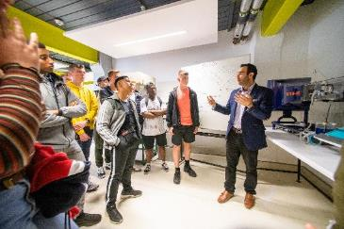
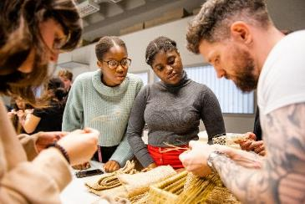
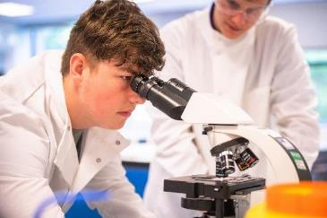
Academic sessions
Pick from over 40 subjects from Architecture to Veterinary Medicine.
Take part in lectures, seminars, practical sessions group projects.
Learn from leading academics with like-minded peers.
Find out if the subject you’ve chosen is for you before you apply to UCAS.
“I wanted to study Medicine since I was little and I came to St Andrews with the mindset that I if I couldn’t study Medicine, I wouldn’t complete my goal of helping people. However, I left knowing that Psychology will also lead me places that I never imagined before. I left St Andrews knowing that there is always another path.”
Radha, London,
St Andrews Summer School 2019
Notes:
What are Sutton Trust Summer Schools? Academic Sessions
Students can choose from over 40 different courses across a range of disciplines including subjects not offered at school including Archaeology, Anthropology, Medicine, Genetics, Electronic Engineering and Asian and Middle Eastern Studies.
You’ll engage with university lecturers and teaching staff to learn about and explore topics at undergraduate level. You may take part in practical sessions, undertake group work and research projects. This is your opportunity to ask questions of both the academic staff about the course content and structure at university and to current undergraduate students about their experience.

Slide 7
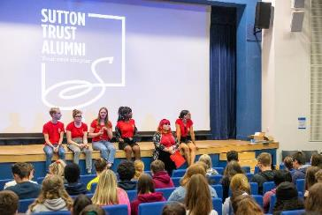
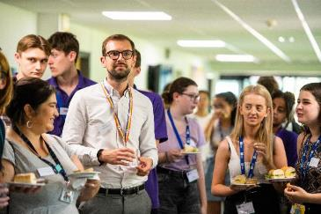
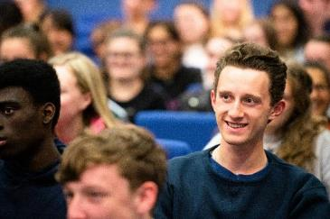
Application help and university support
Receive personal statement support
Understand what you need to do to make your UCAS application stand out
Find out about support services and financial help at university
Explore accommodation options
“I found the programme thoroughly useful as we were able to meet the admissions team and ask them any queries we had directly. We were also given amazing advice on how to prepare for interviews”
Kirthana, Feltham,
Cardiff Summer School 2019
Notes:
What are Sutton Trust Summer Schools? Application Support
Alongside this you’ll receive help with you UCAS application and find out about all the support that will be available to you at university.
Find out about how to make your application stand out, receive top tips on writing your personal statement and how to approach interviews.
You’ll learn about support services you can access at uni, from careers to mental health, as well as student finance including any bursaries and funding support available.

Slide 8
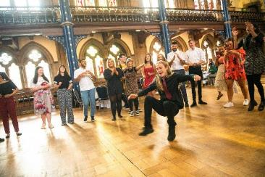
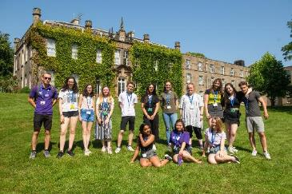
Social activities and university life
Meet like-minded people from across the UK.
Make lifelong friendships.
Sample university societies.
Take part in sports and creative activities.
Explore the university and surrounding area.
Attend celebration events.
“My highlight was meeting new people and getting to know them to become good friends with them through a variety of social activities. I was always shy and didn’t think I would take part but fully engaging and talking to people through fun activities was definitely one of the best parts of the week”
Daniel, Greenock,
Edinburgh Summer School 2019
Notes:
What are Sutton Trust Summer Schools? Social Activities and University Life
The Summer Schools aren’t all about academics and learning – we also want you to have fun and experience the life of a real university student.
You’ll be able to meet people from across the UK both on your course and across the Summer School through a range of social activities. This will include sampling university societies which could be anything from Tai Chi to Circus Skills, American Football to Knitting. There will be other activities which may include talent shows, movie nights, exploring the local town or city or even a trip to the Theatre! Through all of these fun activities you’ll be able to meet new people, try new things and develop new skills.
You’ll get to take part in a celebration event to round off the week with all of your new friends and reflect on everything you’ve achieved

Slide 9
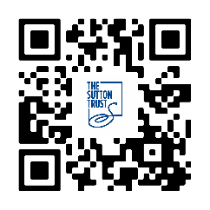
Where can I take part in a Sutton Trust Summer School?
13 leading universities across the UK.
Completely free to attend – all costs including travel are covered.
Dates and subjects vary by university.
For full details go to:
Notes:
Where can I take part in a Sutton Trust Summer School?
Sutton Trust Summer Schools are run in partnership with 13 leading universities across the UK.
The Sutton Trust and university partners completely cover the cost of attending including all travel so you can apply to any university, no matter where you live in the country.
Dates and subject strands vary by university so please check out summerschools.suttontrust.com to check, or scan the QR code.
You can only apply for one course at one university.

Slide 10
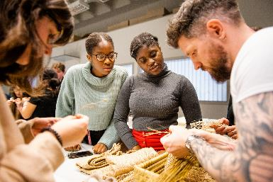
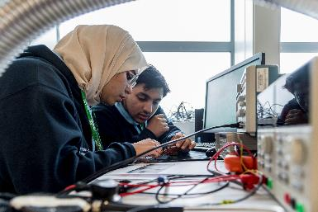
What is the Apprenticeship Summer School?
The Apprenticeship Summer School is a three-day residential programme delivered by the Sutton Trust and leading employers at the University of Warwick.
Students gain a deep understanding of what degree level apprenticeships are, hear from current apprentices, experience networking opportunities, attend interactive sessions hosted by employers and learn the different application processes employers use.
Notes:
What is the Apprenticeship Summer School?
Students will learn what an apprenticeship is, whether the difficult balance of work and study is for them, whether an apprenticeship where they earn whilst learning might be the route they want to pursue.
The programme supports students to make informed decisions about their future career and understand whether an apprenticeship might be for them.
What are Degree Apprenticeships? Degree or professional qualification. No student debt. Earn a salary whilst learning. 80% on the job and 20% off the job study/training.
Not a sector specific programme, but they are still gaining strong skills and application skills from the programme and are looking for similar skills from apprenticeships.

Slide 11
Employers who supported the 2021 programme
Notes:
These are the key employers we have already announced who will be supporting the programme, with more to come!
The three day programme will consist of a variety of different sessions – mixture of group work, employer led sessions and social activities. You will get opportunities to learn the skills and knowledge to understand employer apprenticeship application processes, what they look for in their apprentice cohorts and meet with current apprentices to hear what a normal day looks like for them and how they secured their apprenticeship.

Slide 12
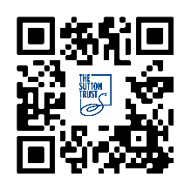
When is the Apprenticeship Summer School?
Tuesday 12th July – Thursday 14th July 2022.
Students have to be available to attend these three days
For full details go to:
Notes:
The Apprenticeship Summer School will run as a residential over three days between Tuesday 12th July – Thursday 14th July 2022 at the University of Warwick.

Slide 13
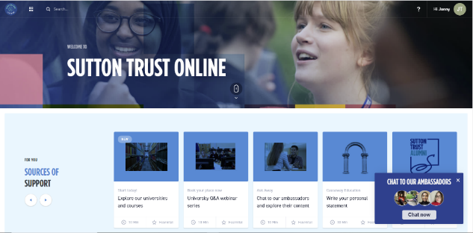
What other support will I get?
Sutton Trust Online
Sutton Trust Online is our new digital platform created to empower young people with the knowledge, skills and confidence they need to achieve their goals.
Over this 18-month programme, participants will be able to:
Attend exclusive webinars and events.
Ask current undergraduates and Sutton Trust Alumni about university life.
Follow a structured programme of curated resources and information.
Receive tailored support with their personal statement.
Get help with admissions tests or interviews.
“Though it was not the ideal situation, I found the programme adapted to the online form well and we still had the regular sessions an in person summer school would have. I loved the more social sides of the day, like the tutor meeting in the morning which helped it feel more personal”
Jasmine, Nottingham, Nottingham Summer School 2020
Notes:
Alongside your Summer School week, you will receive ongoing support from the Sutton Trust in the form of Sutton Trust Online. Sutton Trust Online is our new digital platform that provides you with all the information you might need as you consider your university options. The platform will guide you through exploring your choices, applying to university, preparing for university and then succeeding when you’re there. There is also a wealth of resources and support as well for anyone thinking about degree apprenticeships and careers.
Aside from this library of resources you will also have access to an online personal statement builder called OCSAR, which has been proven to increase offer rates to top universities and the opportunity to have a subject specific mentor who is an expert in university admissions.
We have hundreds of current undergraduate students and Sutton Trust alumni who are studying or have studied every subject under the sun at universities across the UK and beyond and you can speak to all of these people about their university experience and find out what life is really like.
We will be putting on other events and webinars throughout the last two years of school to make sure you have all the information and support you need when you need it, from opportunities to talk directly to university admissions tutors, to revision tips to student finance mythbusting.

Slide 14
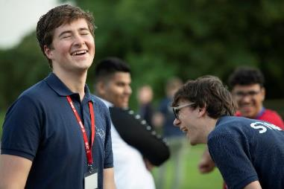
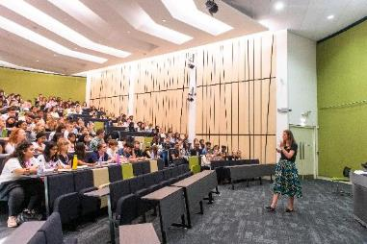
Why take part?
Explore university life first hand.
Try out subjects before applying to university.
Meet likeminded people and make friends from across the UK.
Develop academic and critical thinking skills.
Receive support with your university application.
Take part in activities you might never have considered.
Increase your confidence.
Access to Sutton Trust Online.
Notes:
Why take part?
Sutton Trust undertakes rigorous external evaluation of all of our programmes so we can understand what is working and how to improve what we do. We have undertaken a series of long term projects with participants. This has included tracking student destinations into education and work and comparing this against a number of control groups

Slide 15
Why take part?
4x
16%
93%
7%
69%
UKSS students are four times more likely to receive an offer from a leading university
UKSS students are 16% more likely to attend a Russell Group university
Of UKSS students from the lowest socio-economic group move to the highest after leaving university
Of UKSS students go on to attend Oxford or Cambridge
Of UKSS students go on to attend a Russell Group university
Notes:
Why take part?
As you can see from our evaluations:
UKSS students are four times more likely to receive an offer from a leading university
UKSS students are 16% more likely to attend a Russell Group university
93% of UKSS students from the lowest socio-economic group move to the highest after leaving university
7% of UKSS students go on to attend Oxford or Cambridge
69% of UKSS students go on to attend a Russell Group university.

Slide 16
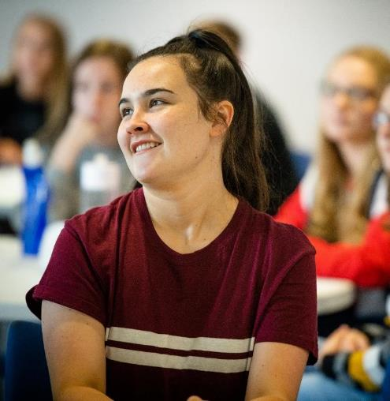
What do previous participants say?
“Thanks to the programme, I have gained lifelong friends, as well as an insight into what I would like to study. The programme made me feel a lot more at home knowing that people that have gone through similar challenges to me.
I have difficulty adapting to change and the Sutton Trust put me at ease and helped me understand what university life would entail. I have gained a lot more confidence in myself and in my ability to apply to university”
Anna, Johnstone, University of Edinburgh Summer School 2020

Slide 17
Who can apply?
Mandatory Criteria
Additional Criteria
Are currently in:
Year 12 (England and Wales)
Year 13 (Northern Ireland)
S5 (Scotland)
We look at a number of additional criteria to offer places on the programme. These include:
Grades achieved
Your background
Your school’s context
Where you live
The more of these criteria you meet, the more likely you are to receive a place
Attend, and have always attended, a state (non fee-paying) school
All students that apply to a university or apprenticeship summer school that meet our grades threshold and another of our criteria will be offered a place on the STO Core programme.
Notes:
Who we’re looking for?
Sutton Trust can accept applications from students who have always attended state schools, and are in Year 12 in England and Wales, S5 in Scotland or Year 13 in Northern Ireland. You do not need to fulfil any of our other criteria to apply, but the more you meet, the more likely you are to be offered a place.
All students that apply to a university or apprenticeship summer school that meet our grades threshold and another of our criteria will be offered a place on the STO Core programme.

Slide 18
How do I apply?
Choose which university and course you want to apply for at summerschools.suttontrust.com.
All students that apply to our Summer Schools that meet our grades threshold and another of our criteria will be offered a place on the STO Core programme in March.
Complete the online application form at apply.suttontrust.com by midday Wednesday 9th March 2022.
No late applications!
The university you have applied to will let you know by May whether you have a place on the Summer School
Attend your summer school in person or face to face. Dates will vary by university and course
Nominate a teacher to verify your application by 9am 14th March 2022.
Join the Sutton Trust’s outstanding alumni community
Notes:
Application Process
The deadline for our UK Summer School and Apprenticeship Summer School application are on Wednesday 9th March 2022 – no late applications! Nominate a teacher to verify your application by 9am 14th March 2022.
The university you have applied to will let you know by the end of April whether you have a place on the Summer School. Receive access to Sutton Trust Online in May for ongoing support throughout your last year of school or college.
For more information, and how to apply, please check the summerschools.suttontrust.com website.

